Slide 1

Historians and Open Access
The View from the Tenure Track
Ian Milligan
Assistant Professor

Slide 2
CHA on Open Access
Thank you for asking us for our feedback on the the Draft Tri-Agency Open Access Policy. The CHA is closely following the speedy developments on open access.
We have identified five major areas of concerns:
- That any transition to a more open model does not come at the expense of smaller publications such as that of our association, the Journal of the Canadian Historical Association;
- Particularly for professional and academic associations like ours, the financial health and strength of the organization depend largely on the health of these publications. Associations like ours would be very vulnerable;
- That any transition will not compromise the possibility for researchers who are not well-off to continue to publish since many of the new models seem to ask the authors to finance some of the costs of production;
- The reasoning of granting agencies which equates openness, free and public money is often too rushed, simplistic and erroneous. It is part of a speech that the Federation and its members are well placed to criticize, and put in the context of debates and reflections on the nature of public life;
- Nothing has been said about how SSHRC intends to support journals that decide to adopt an open access policy.

Slide 3
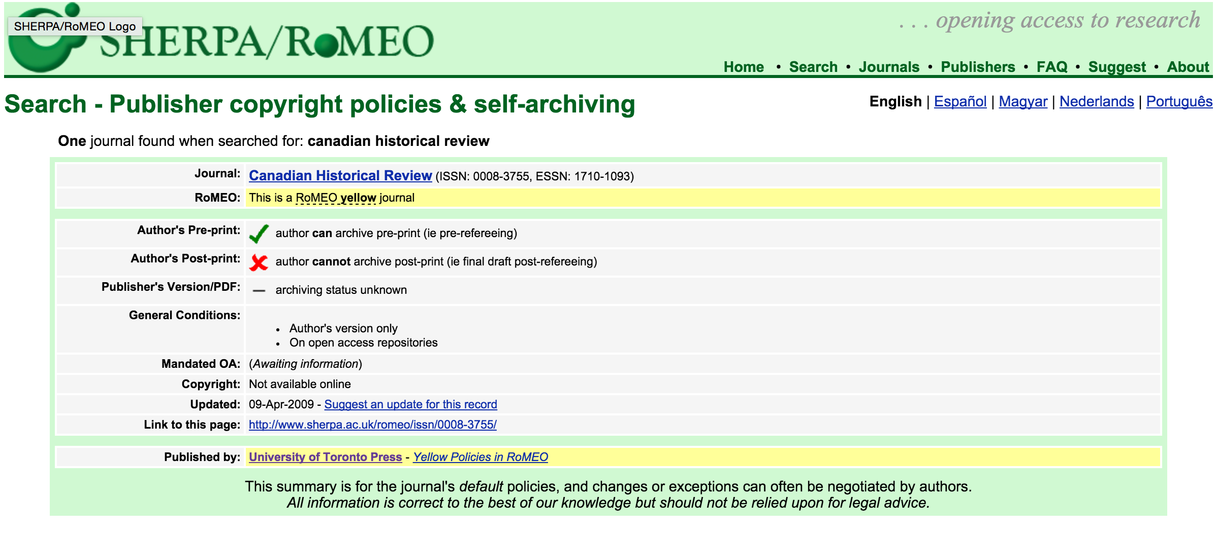

Slide 4
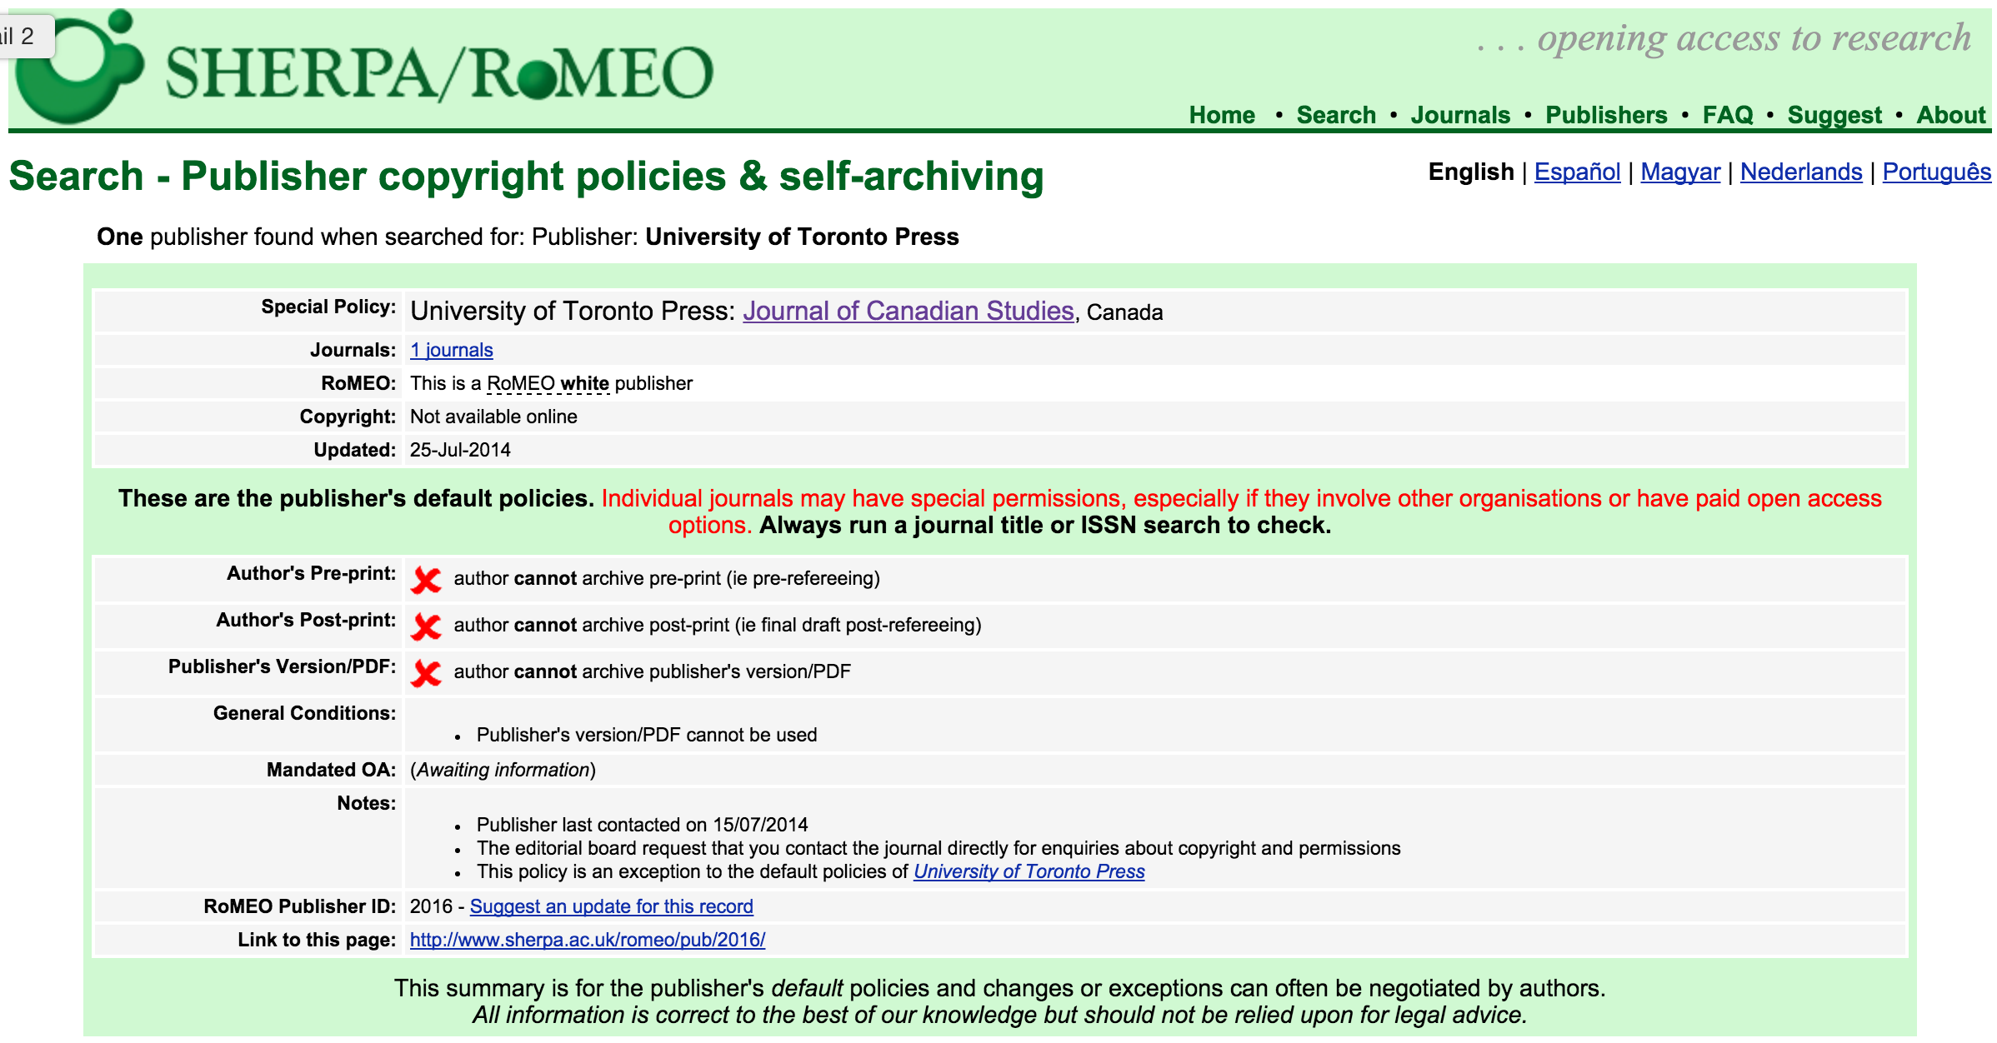

Slide 5
Why?
Misinformation
Love of paper
Fear of change
Historian self-management

Slide 6
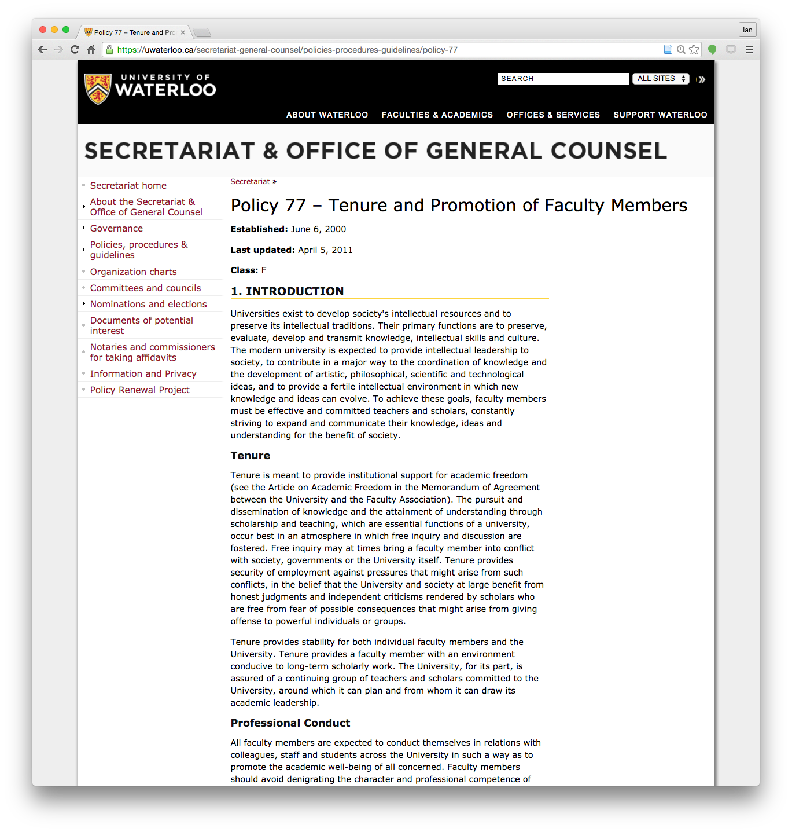
Why?

Slide 7
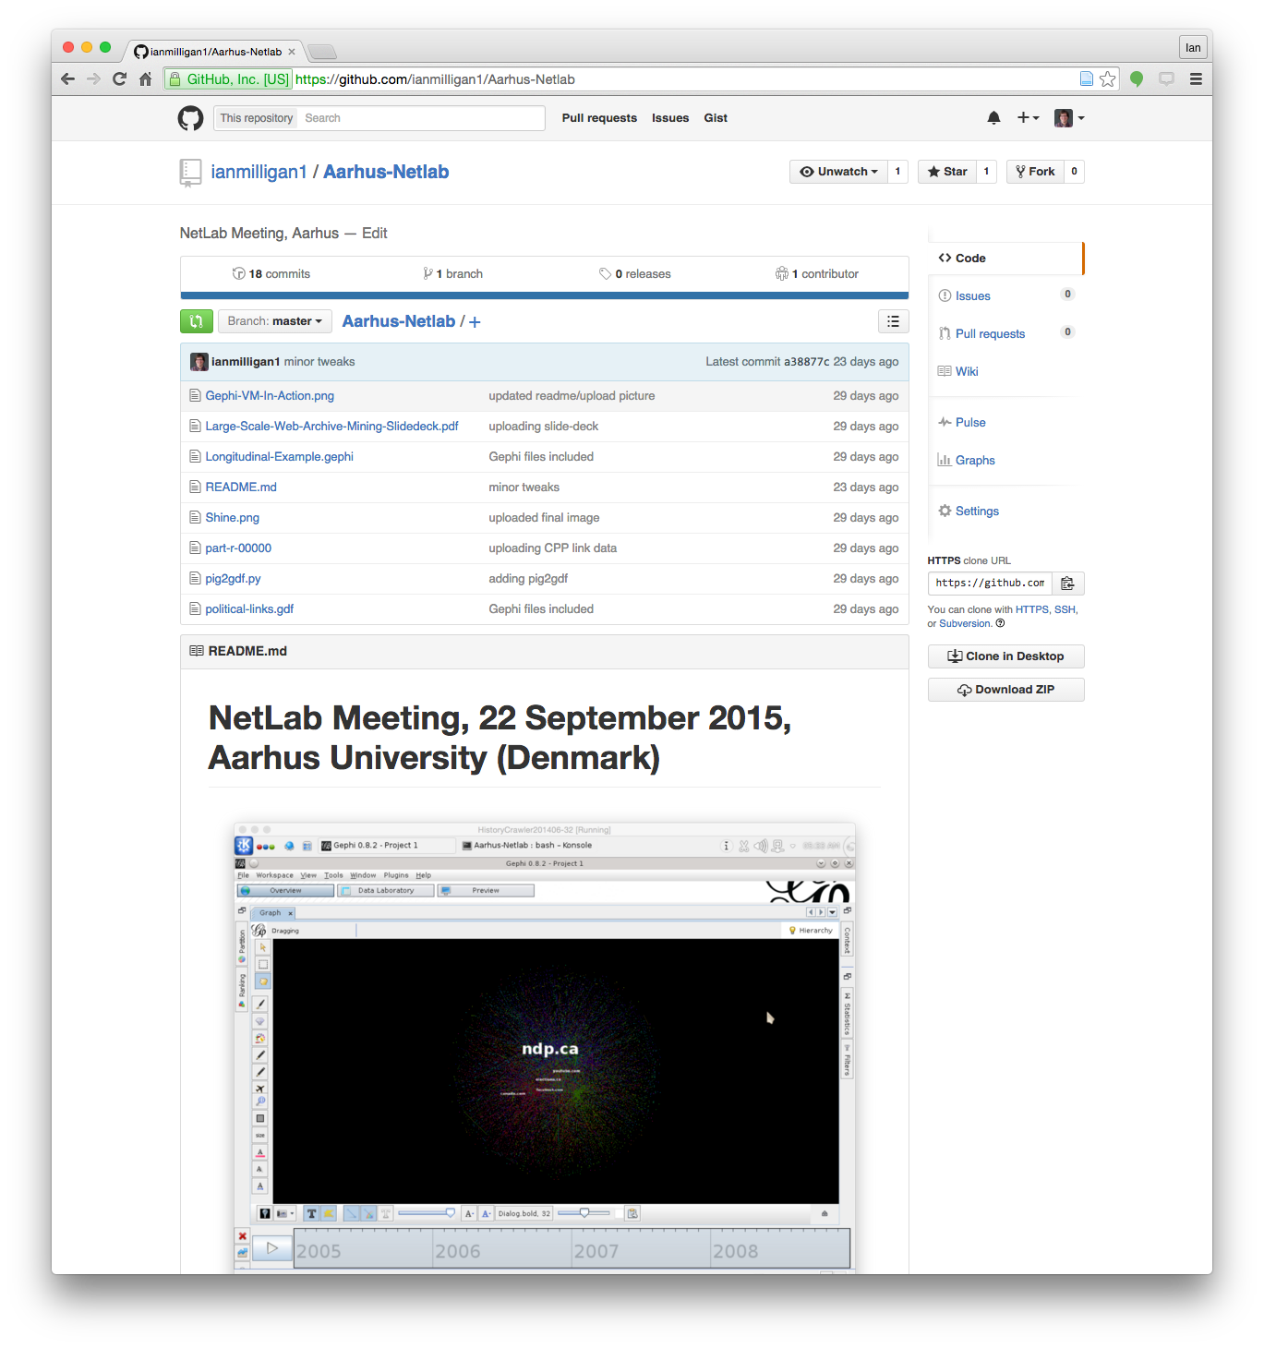
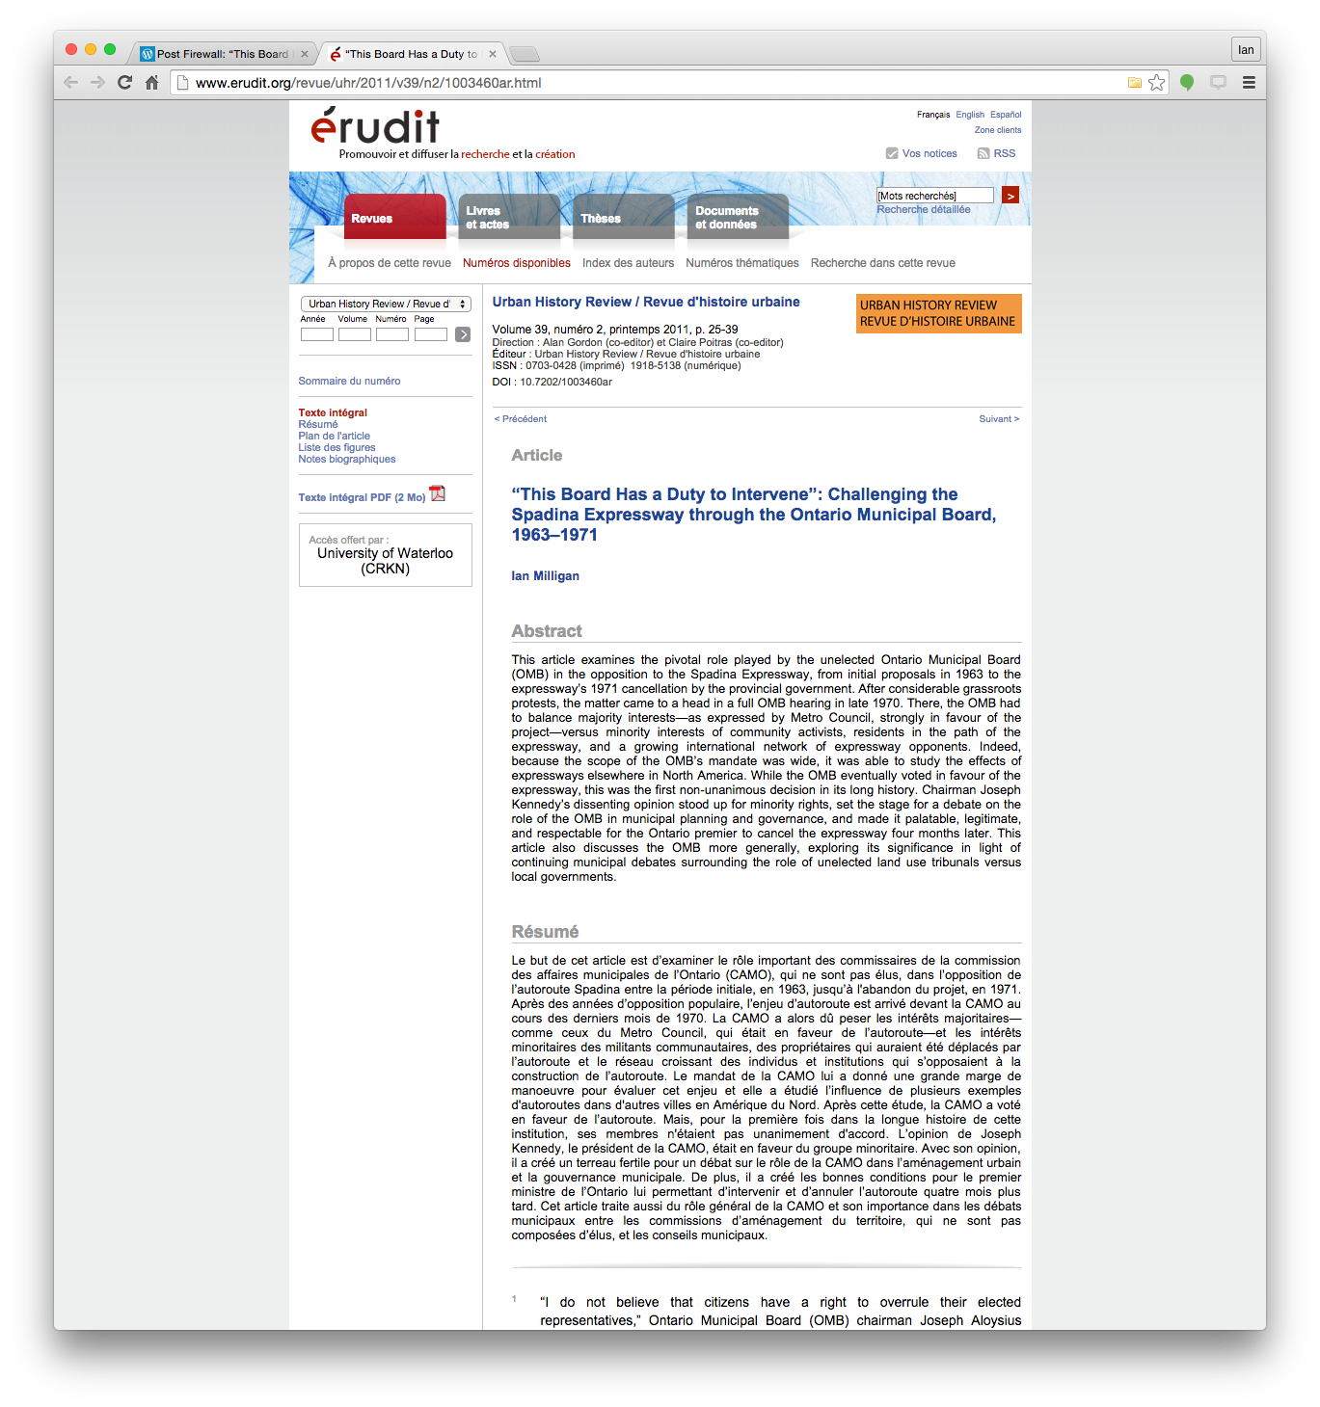
What to do?

Slide 8
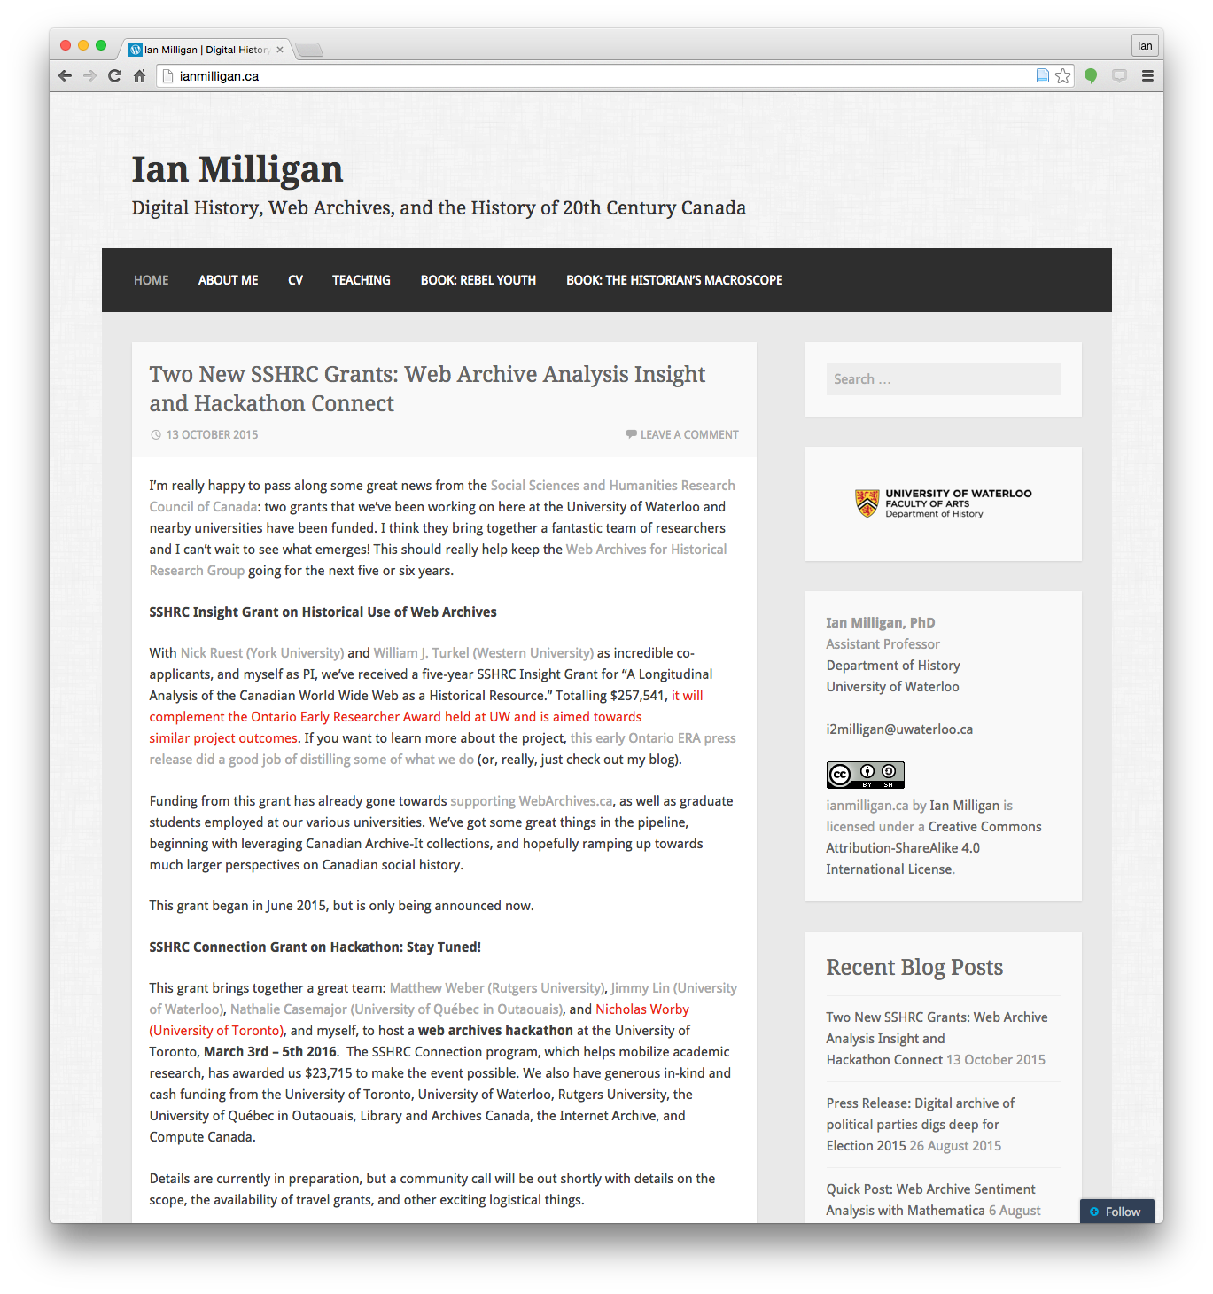
Writing in Public

Slide 9
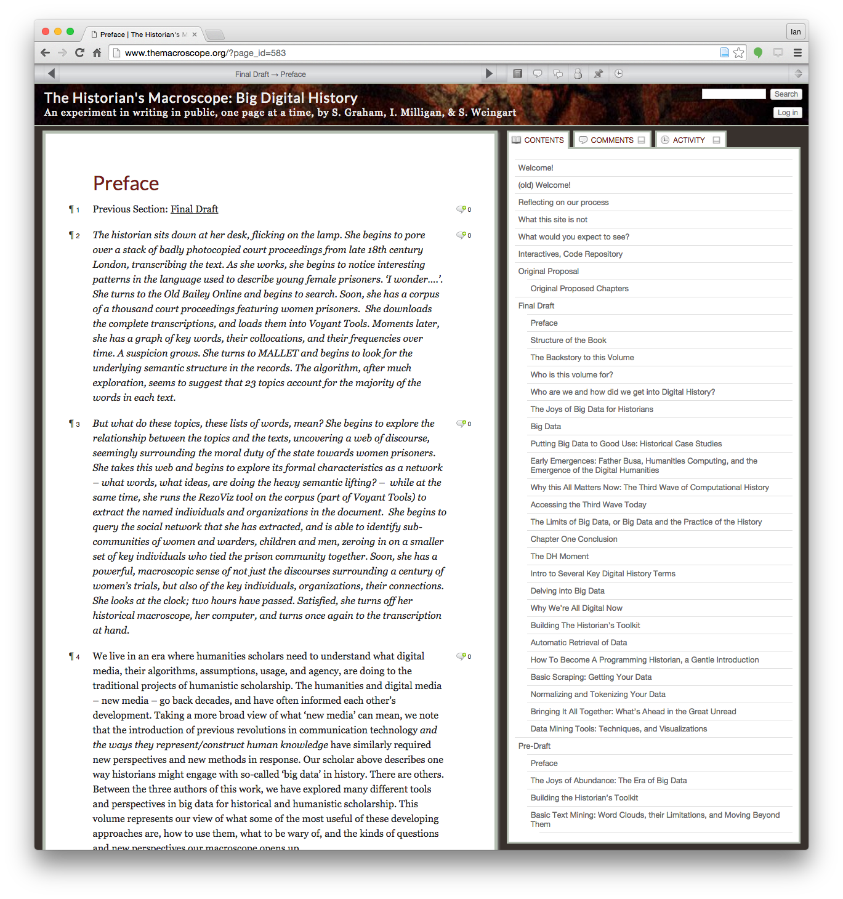
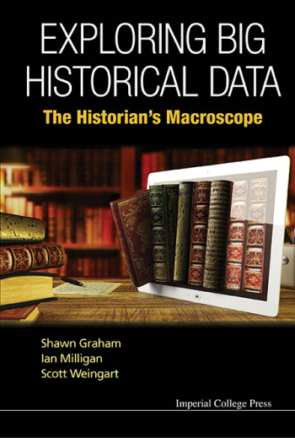
Writing in Public

Slide 10
Thanks and Conclusions
Ian Milligan
Assistant Professor

